Slide 1
Discovery and Evaluation Solution on Zero-Hour Phishing Websites
Justin Matte
Olga Surzhok
Supervisor: Miguel Garzon

Slide 2
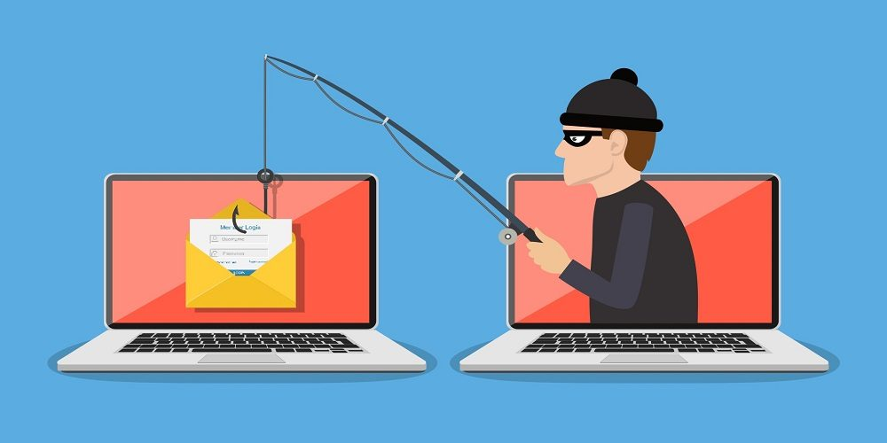
Problem Statement
Well-known domain names are used with intent of stealing consumer’s information such as passwords, email, and banking information
Traffic sent to malicious websites by misspelling popular domain names or adding common key words like “support”
Apparent need for legitimate domain owners to detect new phishing domain as early as possible to minimize the damage to their customers

Slide 3
Proposed Solution

Slide 4
Discovery

Slide 5
Evaluation

Slide 6
Challenges
Long execution time

Slide 7
Results

